Slide 1





ALGORITHMIC TRADING
Team : Dhanush kumar P and dhanushpandi6374@gmail.com Guide: P.Raja
Disclaimer: The content is curated for educational purposes only.
Notes:
Slides: Prepare a short slide deck (10-12 slides) summarizing the project objectives, methodology, and key results.

Slide 2
OUTLINE
Abstract of the Project
Problem Statement
Proposed Solution
System Architecture
Live Demo of the Project
Embedded Video of Project
Conclusion
Future Scope

Slide 3
Abstract
Algorithmic trading (also known as algo-trading or automated trading) refers to the use of computer algorithms to execute financial market transactions based on predefined criteria. These algorithms are designed to analyze market conditions, identify trading opportunities, and execute trades at optimal times and prices, often at speeds far surpassing human traders. The primary advantages of algorithmic trading include the ability to process vast amounts of data, minimize human error, and capitalize on market inefficiencies through high-frequency trading strategies. Algorithms can be developed using various techniques, including statistical arbitrage, machine learning, and artificial intelligence, to identify patterns and predict market trends. While algo-trading has transformed the financial industry by increasing market liquidity and reducing transaction costs, it has also introduced risks, such as the potential for market manipulation and flash crashes. This paper explores the evolution of algorithmic trading, its various strategies, technological advancements, regulatory considerations, and its impact on market dynamics. Additionally, it addresses key challenges and ethical concerns surrounding the automation of financial decision-making in a highly competitive and fast-paced environment.
.

Slide 4
Problem Statement
Algorithmic trading, while enhancing market efficiency and liquidity, presents significant challenges, including risks of market instability, flash crashes, and lack of transparency in trading strategies. The complexity of algorithms, often functioning as "black boxes," makes it difficult to assess potential risks and biases, raising concerns about market fairness and regulatory compliance. Additionally, the rapid pace of high-frequency trading (HFT) introduces the potential for market manipulation and price distortions. Addressing these issues requires the development of more transparent, robust, and ethical algorithmic trading systems that balance automation with necessary human oversi

Slide 5
Proposed Solution
.
To address the challenges of algorithmic trading, the proposed solution includes enhancing **transparency** through explainable AI, ensuring **real-time risk management** with dynamic controls like circuit breakers, and establishing **regulatory standards** for algorithmic strategies. Additionally, a **hybrid human-AI approach** would enable experienced traders to oversee automated systems, while **machine learning** algorithms adapt to market changes. Finally, fostering **ethical AI development** ensures fairness, accountability, and long-term market stability. This integrated approach aims to improve the reliability, transparency, and ethical standards of algorithmic trading systems.

Slide 6
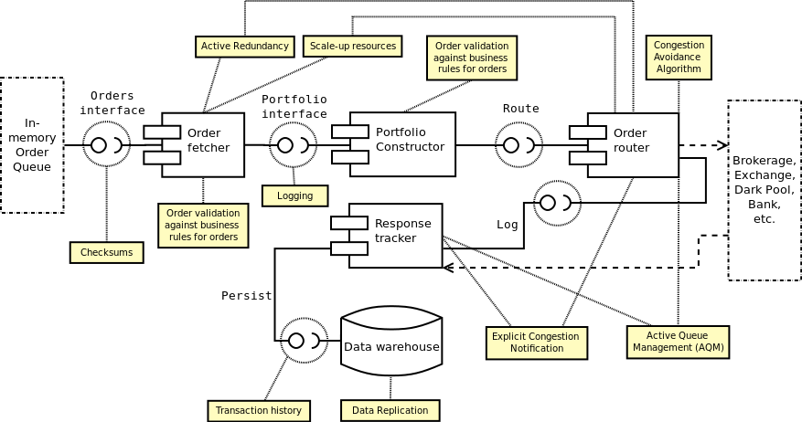
System Architecture

Slide 7
Live Demo of Project

Slide 8
Video of Project Demo

Slide 9
Conclusion
Algorithmic trading has undeniably transformed financial markets, offering significant advantages such as increased efficiency, liquidity, and the ability to process vast amounts of data in real-time. However, its rapid growth has introduced several challenges, including market instability, lack of transparency, and ethical concerns about fairness and manipulation. To ensure the continued success and sustainability of algorithmic trading, it is crucial to implement solutions that address these issues.
By enhancing transparency through explainable AI, improving real-time risk management, establishing comprehensive regulatory frameworks, and promoting a balanced hybrid of human oversight and automation, the risks associated with algorithmic trading can be significantly mitigated. Furthermore, incorporating ethical principles into the development and deployment of algorithms will help foster a fairer and more stable market environment.
Ultimately, the future of algorithmic trading lies in creating systems that are not only efficient and profitable but also transparent, accountable, and responsible. With the right safeguards in place, algorithmic trading can continue to play a pivotal role in shaping the future of global financial markets.

Slide 10
Future Scope
The future of algorithmic trading will be shaped by advances in **AI and machine learning**, enabling more adaptive and predictive trading strategies. **Quantum computing** could enhance data processing and optimization, while **blockchain** and **DeFi** may offer decentralized, transparent, and faster trading platforms. As market complexity increases, **cross-asset strategies** and **autonomous trading ecosystems** will emerge, allowing algorithms to manage portfolios across multiple asset classes and markets. Ethical considerations will lead to the development of **responsible AI**, focusing on fairness and sustainability. Regulatory frameworks will evolve to ensure transparency and accountability in an increasingly automated financial landscape.

Slide 11
Thank you!
Notes:
thank you very much for joining this PPT, keep learning.
11

